Slide 1



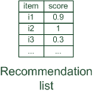

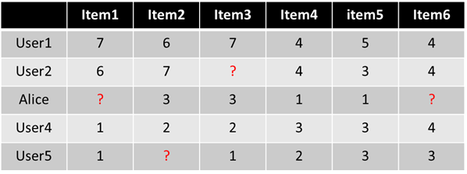
Collaborative filtering
Collaborative: "Tell me what's popular among my peers"

Slide 2
Collaborative Filtering
Collaborative filtering can be viewed as a generalization of classification and regression problems, the methodologies for the latter classes of problems can also be applied to the former

Slide 3
Classification
Classification
predicts categorical class labels (discrete or nominal)
classifies data (constructs a model) based on the training set and the values (class labels) in a classifying attribute and uses it in classifying new data

Slide 4
Process (1): Model Construction
Classification
Algorithms
Training
Data
Classifier
(Model)
IF rank = ‘professor’
OR years > 6
THEN tenured = ‘yes’

Slide 5
Process (2): Using the Model in Prediction
IF rank = ‘professor’
OR years > 6
THEN tenured = ‘yes’
Classifier
Testing
Data
Unseen Data
(Jeff, Professor, 4)
Tenured?

Slide 6
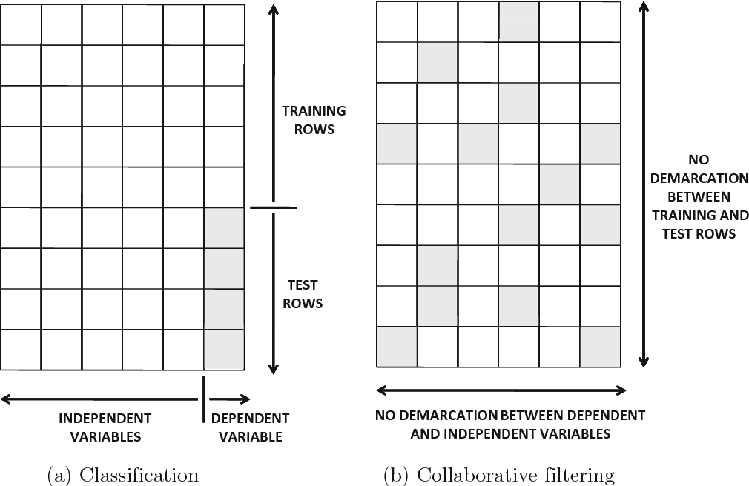
Collaborative Filtering as a Generalization of Classification and Regression Modeling
Collaborative filtering methods can be viewed as generalizations of classification and regression
modeling.

Slide 7
Lazy Learner : The k-Nearest Neighbor Algorithm
All instances correspond to points in the n-D space
The nearest neighbor are defined in terms of Euclidean distance, dist(X₁, X₂)
Target function could be discrete- or real- valued
For discrete-valued, k-NN returns the most common value among the k training examples nearest to x_{q}
_
_
_
.
+
_
+
_
x_{q}
+
_
+

Slide 8
Lazy Learner : The k-Nearest Neighbor Algorithm
k-NN for real-valued prediction for a given unknown tuple
Returns the mean values of the k nearest neighbors
Distance-weighted nearest neighbor algorithm
Weight the contribution of each of the k neighbors according to their distance to the query x_{q}
Give greater weight to closer neighbors
_
_
_
.
+
_
+
+
_
+
x_{q}
_

Slide 9
Neighborhood-based methods
Neighborhood-based methods are generalizations of instance-based learning methods or lazy learning methods in which the prediction approach is specific to the instance being predicted
 | Item1 | Item2 | Item3 | Item4 | Item5
Alice | 5 | 3 | 4 | 4 | ?
User1 | 3 | 1 | 2 | 3 | 3
User2 | 4 | 3 | 4 | 3 | 5
User3 | 3 | 3 | 1 | 5 | 4
User4 | 1 | 5 | 5 | 2 | 1
sim = 0,85
sim = 0,00
sim = 0,70
sim = -0,79

Slide 10
Strengths and Weaknesses of Neighborhood-Based Methods
Adv
easy to implement and debug.
easy to justify why a specific item is recommended
the recommendations are relatively stable
Disadv
offline phase can sometimes be impractical in large-scale settings
user-based method requires at least O(m²) time and space. This might sometimes be too slow or space-intensive with desktop hardware, when m is of the order of tens of millions
Their limited coverage because of sparsity.
For example, if none of John’s nearest neighbors have rated Terminator, it is not possible to provide a rating prediction of Terminator for John.
Clustering
Dimensionality reduction

Slide 11
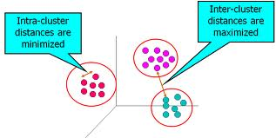
Cluster Analysis
Unsupervised learning (i.e., Class label is unknown)
Group data to form new categories (i.e., clusters)
Principle: Maximizing intra-class similarity & minimizing interclass similarity
Many methods and applications

Slide 12
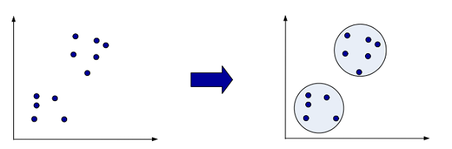
Clustering and Neighborhood-based Methods
The main problem with neighborhood-based methods is the complexity of the offline phase, which can be quite significant when the number of users or the number of items is very large.
The main idea of clustering-based methods is to replace the offline nearest-neighbor computation phase with an offline clustering phase.
The pairwise similarity computation needs to be performed only within the same cluster
The top-k closest peers within the same cluster are used to perform the prediction.

Slide 13
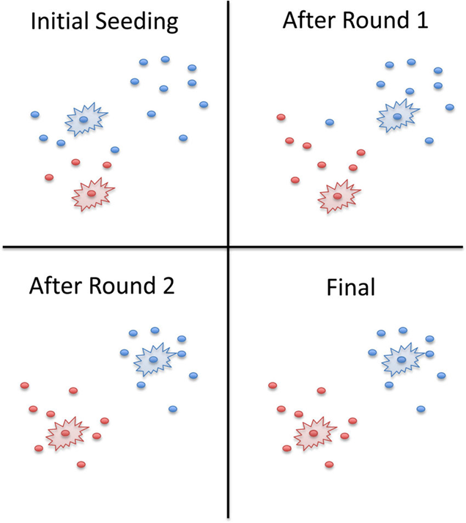
K-means Algorithm
Given the cluster number K, the K-means algorithm is carried out in three steps after initialization:
Initialization: set seed points (randomly)
Assign each object to the cluster of the nearest seed point measured with a specific distance metric
Compute new seed points as the centroids of the clusters of the current partition (the centroid is the centre, i.e., mean point, of the cluster)
Go back to Step 1, stop when no more new assignment (i.e., membership in each cluster no longer changes)

Slide 14
Dimensionally Reduction and Neighborhood methods
Dimensionality reduction methods can be used to improve neighborhood-based methods both in terms of quality and in terms of efficiency.
A reduced representation of the data can be created in terms of either row-wise latent factors or in terms of column-wise latent factors.

Slide 15
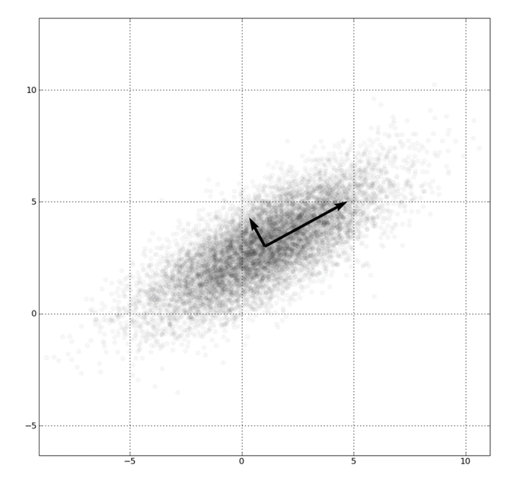
PCA
 | A₁ | A₂
X1 | 3 | 2
X2 | 4 | 3
X3 | 6 | 2
X4 | 5 | 2
X5 | 6 | 3
Principal Components Analysis (PCA) is a technique that can be used to simplify a dataset
It is a linear transformation that chooses a new coordinate system for the data set such that
greatest variance by any projection of the data set comes to lie on the first axis (then called the first principal component)
the second greatest variance on the second axis, and so on.

Slide 16
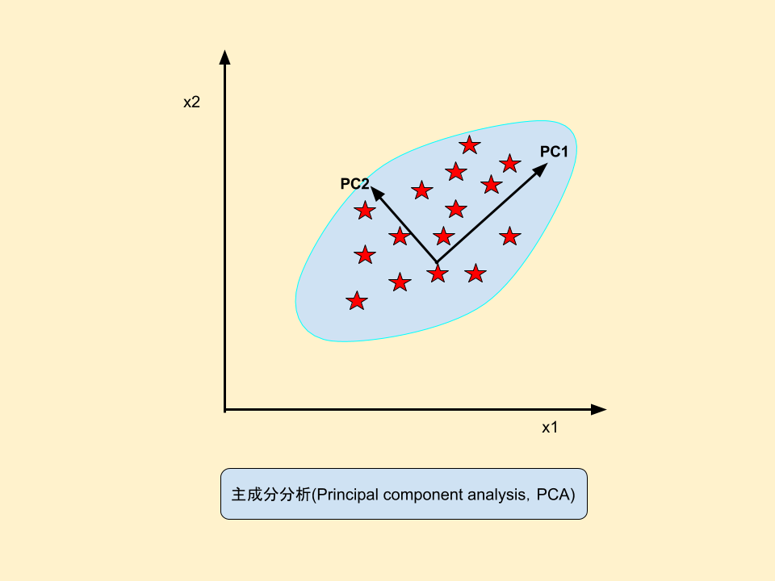
Principal Component Analysis (PCA)
Find a projection that captures the largest amount of variation in data
By finding the eigenvalues and eigenvectors of the covariance matrix, we find that the eigenvectors with the largest eigenvalues correspond to the dimensions that have the strongest correlation in the dataset.

Slide 17
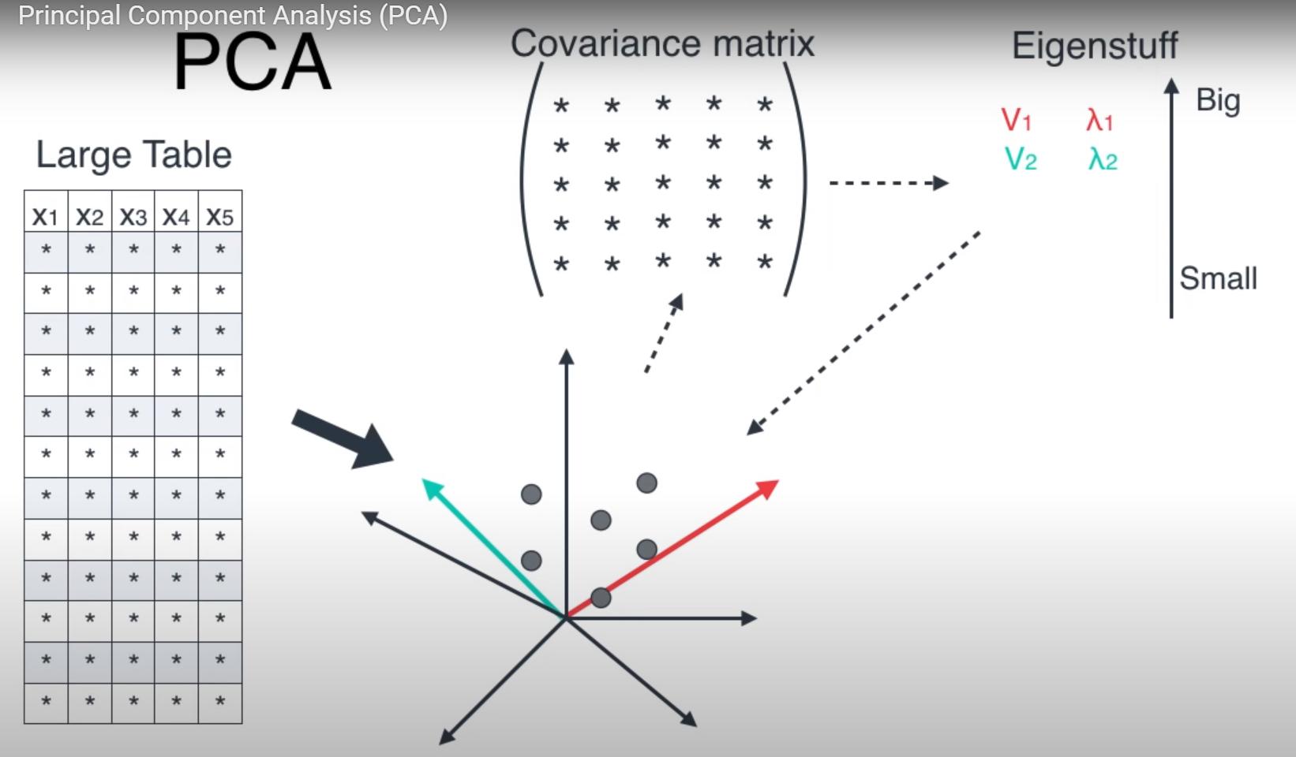
Example

Slide 18
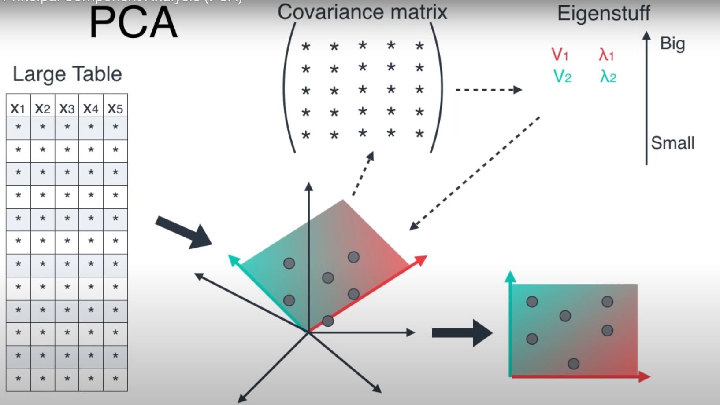
Example

Slide 19
Model-based methods
In model-based methods, a summarized model of the data is created up front
the training (or model building phase) is clearly separated from the prediction phase.
traditional machine learning methods include decision trees, rule-based methods, Bayes classifiers, regression models, and neural networks
Almost all these models can be generalized to the collaborative filtering scenario, just as k-nearest neighbor classifiers can be generalized to neighborhood-based models for collaborative filtering.

Slide 20
Model-based recommender systems
Model-based recommender systems often have a number of advantages over neighborhood-based methods:
Space-efficiency
Training speed and prediction speed

Slide 21
Model-based recommender systems
Decision tree
Rule-Based Collaborative Filtering
Native Bayes Collaborative Filtering
Latent factor models

Slide 22
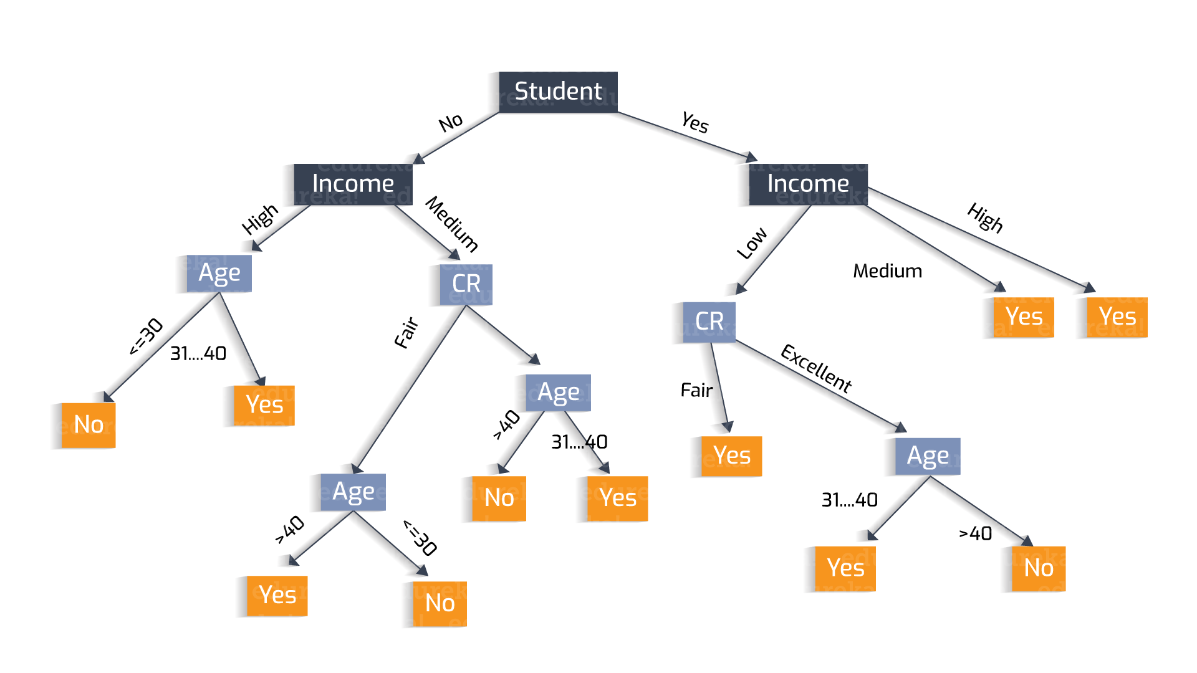
Decision Trees
Decision and regression trees are frequently used in data classification.

Slide 23
Decision Tree Induction: An Example
Training data set: Buys_computer
Resulting tree:
[age>40, income=high, student=yes, c_r=fair]
age?
<=30
overcast
>40
31..40
student?
yes
credit rating?
no
yes
excellent
fair
no
yes
no
yes

Slide 24
Algorithm for Decision Tree Induction
Basic algorithm (a greedy algorithm)
Tree is constructed in a top-down recursive divide-and-conquer manner
At start, all the training examples are at the root
Attributes are categorical (if continuous-valued, they are discretized in advance)
Examples are partitioned recursively based on selected attributes
Test attributes are selected on the basis of a heuristic or statistical measure (e.g., information gain)
Conditions for stopping partitioning
All samples for a given node belong to the same class
There are no samples left
There are no remaining attributes for further partitioning – majority voting is employed for classifying the leaf

Slide 25
Attribute Selection Measure: Information Gain (ID3/C4.5)
Select the attribute with the highest information gain
Let p_{i} be the probability that an arbitrary tuple in D belongs to class C_{i}, estimated by |C_{i, D}|/|D|
Expected information (entropy) needed to classify a tuple in D:
Information needed (after using A to split D into v partitions) to classify D:
Information gained by branching on attribute A
Notes:
I : the expected information needed to classify a given sample
E (entropy) : expected information based on the partitioning into subsets by A

Slide 26
Entropy
Category : a, b
S₁={a, a, a, a, a, a}
S₂={a, a, a, b, b, b}

Slide 27
Attribute Selection: Information Gain
Class P: buys_computer = “yes”
Class N: buys_computer = “no”
Similarly,

Slide 28
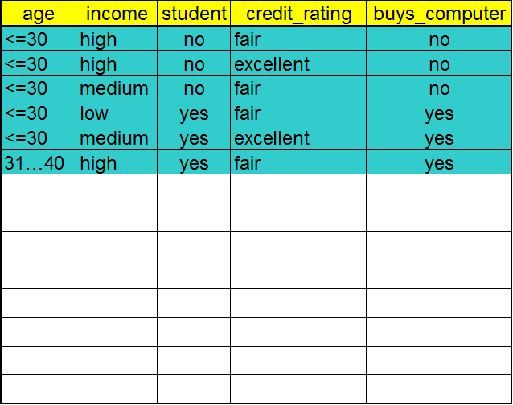
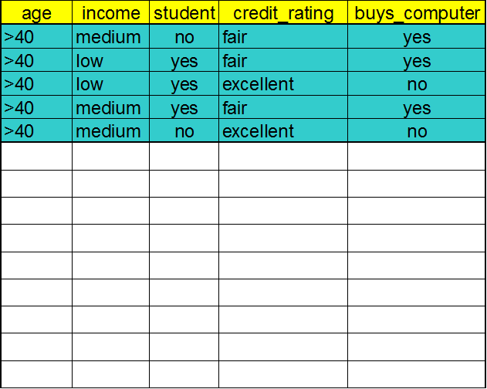
Decision tree
age?
<=30
>40
31..40
yes

Slide 29
Output: A Decision Tree for “buys_computer”
age?
<=30
overcast
>40
31..40
student?
yes
credit rating?
no
yes
excellent
fair
no
yes
no
yes

Slide 30
Exercise
Compute Information Gain by branching on Attribute Income
Income | Age | Credit | Class label
l | 20-29 | good | T
l | 30-39 | good | F
l | 40-49 | good | F
m | 20-29 | fair | F
m | 30-39 | fair | F
m | 40-49 | fair | T
h | 40-49 | good | F
h | 20-29 | good | T
h | 30-39 | fair | T
h | 40-49 | fair | T

Slide 31
Gini Index (CART, IBM IntelligentMiner)
If a data set D contains examples from n classes, gini index, gini(D) is defined as
where p_{j} is the relative frequency of class j in D
If a data set D is split on A into two subsets D₁ and D₂, the gini index gini(D) is defined as
Reduction in Impurity:
The attribute provides the smallest gini_{split}(D) (or the largest reduction in impurity) is chosen to split the node (need to enumerate all the possible splitting points for each attribute)
impurity

Slide 32
Computation of Gini Index
D has 9 tuples in buys_computer = “yes” and 5 in “no”
Student
student | p_{i} | n_{i} | gini
yes | 6 | 1 | 1-(6/7)²-(1/7)²=0.246
no | 3 | 4 | 1-(3/7)²-(4/7)²=0.490
gini_{student}(D)=(7/14)* 0.246+ (7/14)*0.490=0.368
Δgini(student)=0.459-0.368=0.091

Slide 33
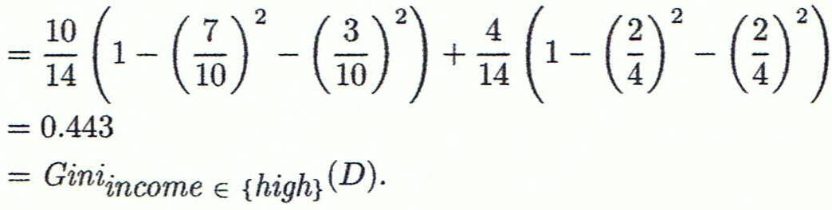
Computation of Gini Index
Ex. D has 9 tuples in buys_computer = “yes” and 5 in “no”
Suppose the attribute income partitions D into 10 in D₁: {low, medium} and 4 in D₂
Gini_{{low,high}} is 0.458; Gini_{{medium,high}} is 0.450. Thus, split on the {low,medium} (and {high}) since it has the lowest Gini index

Slide 34
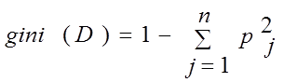
{(low, high), medium} 0.458
{(medium, high), low} 0.450
income?
Low, medium
high
no
yes
no
yes

Slide 35

Extending decision trees to collaborative filtering
The main challenge in extending decision trees to collaborative filtering
the predicted entries and the observed entries are not clearly separated in column-wise
the ratings matrix is very sparsely populated

Slide 36

The predicted entries and the observed entries are not clearly separated in column-wise
construct separate decision trees to predict the rating of each item

Slide 37
The ratings matrix is very sparsely populated
Create a lower-dimensional representation of the data using the dimensionality reduction methods
At the very beginning, the m × (n − 1) ratings matrix, excluding the jth column, is converted into a lower-dimensional m×d representation, in which d ≪ n−1 and all attributes are fully specified.
This reduced representation is used to construct the decision tree for the jth item by treating the problem as a standard classification or regression modeling problem.

Slide 38
Rule-Based Collaborative Filtering

Slide 39




Slide 40

Rule-Based Collaborative Filtering
1 | nail polish，ring，perfume
2 | nail polish，perfume
3 | flower，chocolate，perfume
4 | chocolate，perfume
5 | nail polish，cosmetic，perfume
6 | flower，chocolate
Buy Perfume
Recommend items?

Slide 41

Example
1 | female | nail polish，ring，perfume
2 | female | nail polish，perfume
3 | male | flower，chocolate，perfume
4 | male | chocolate，perfume
5 | female | nail polish，cosmetic，perfume
6 | male | flower，chocolate

Slide 42
Example
1 | Jan. | nail polish，ring，perfume
2 | Jan. | nail polish，perfume
3 | Feb. | flower，chocolate，perfume
4 | Feb. | chocolate，perfume
5 | Feb. | nail polish，cosmetic，perfume
6 | Mar. | flower，chocolate

Slide 43
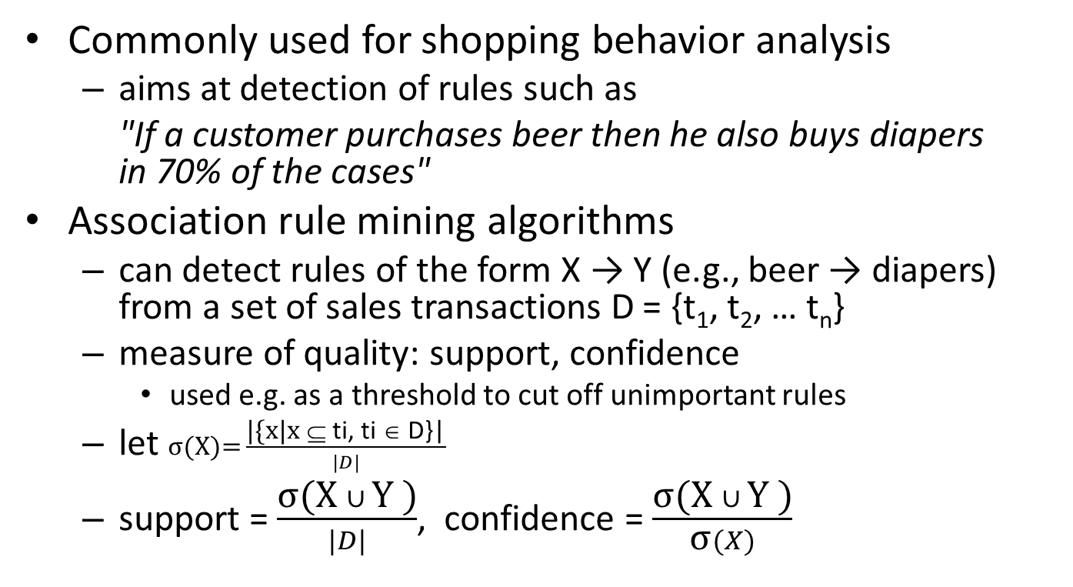
Association rule mining
Commonly used for shopping behavior analysis
aims at detection of rules such as
"If a customer purchases beer then he also buys diapers in 70% of the cases"
Association rule mining algorithms
can detect rules of the form X → Y (e.g., beer → diapers) from a set of sales transactions D = {t₁, t₂, … t_{n}}
measure of quality: support, confidence
used e.g. as a threshold to cut off unimportant rules
let $\text{σ}\text{(}\text{X}\text{)=}\frac{\text{|\{}\text{x}\text{|}\text{x} \text{⊆ }\text{ti}\text{, }\text{ti}\text{ ∈ }\text{D}\text{\}|}}{|D|}$
support = $\frac{\text{σ}\text{(}\text{X} ∪ \text{Y}\text{ )}}{|D|}$, confidence = $\frac{\text{σ}\text{(}\text{X} ∪ \text{Y}\text{ )}}{\text{σ}(X)}$

Slide 44
Basic Concepts: Frequent Patterns
Tid | Items bought
10 | Beer, Nuts, Diaper
20 | Beer, Coffee, Diaper
30 | Beer, Diaper, Eggs
40 | Nuts, Eggs, Milk
50 | Nuts, Coffee, Diaper, Eggs, Milk
itemset: A set of one or more items
{Beer}, {Beer, Nuts}, …
k-itemset X = {x₁, …, x_{k}}
(absolute) support, or, support count of X: Frequency or occurrence of an itemset X
{Beer}: 3, {Beer, Nuts}=1
(relative) support, s, is the fraction of transactions that contains X (i.e., the probability that a transaction contains X)
{Beer}: 3/5, {Beer, Nuts}=1/5
Customer
buys both
Customer
buys diaper
Customer
buys beer

Slide 45

Basic Concepts: Frequent Patterns
Tid | Items bought
10 | Beer, Nuts, Diaper
20 | Beer, Coffee, Diaper
30 | Beer, Diaper, Eggs
40 | Nuts, Eggs, Milk
50 | Nuts, Coffee, Diaper, Eggs, Milk
An itemset X is frequent if X’s support is no less than a minsup threshold
minsup=0.5
{Beer} is a frequent(large) itemset
Confidence of a rule X->Y
conditional probability that a transaction having X also contains Y
Eggs->Nuts
2/3
Customer
buys both
Customer
buys diaper
Customer
buys beer

Slide 46
Exercise
Support = ?
{A}
{A, B}
{B, C}
{A, B, C}
Confidence = ?
{A}-> {B, C}
{A, B} -> {C}
{B, C}-> {A}
Tid | Items bought
10 | A,B,C
20 | A,C
30 | A,B,C,D
40 | B,C
50 | A,B,C

Slide 47
Basic Concepts: Association Rules
Tid | Items bought
10 | Beer, Nuts, Diaper
20 | Beer, Coffee, Diaper
30 | Beer, Diaper, Eggs
40 | Nuts, Eggs, Milk
50 | Nuts, Coffee, Diaper, Eggs, Milk
Find all the rules X → Y with minimum support and confidence
support, s, probability that a transaction contains X ∪ Y
confidence, c, conditional probability that a transaction having X also contains Y
Let minsup = 50%, minconf = 50%
Freq. Pat.: Beer:3, Nuts:3, Diaper:4, Eggs:3, {Beer, Diaper}:3
Customer
buys both
Customer
buys diaper
Customer
buys beer
Association rules: (many more!)
Beer → Diaper (60%, 100%)
Diaper → Beer (60%, 75%)

Slide 48
Basic Concepts: Association Rules
Two steps
Finding frequent itemsets
Generating association rules

Slide 49
Recommendation based on Association Rule Mining
Make recommendations for Alice (basic method)
Determine "relevant" rules based on Alice's transactions
Ex: item1 -> ?, item 3 -> ?, item1 and item3 -> ?, etc.
Determine items not already bought by Alice
Sort the items based on the rules' confidence values
 | Item1 | Item2 | Item3 | Item4 | Item5
Alice | 1 | 0 | 1 | 0 | 0
User1 | 1 | 0 | 1 | 0 | 1
User2 | 1 | 0 | 1 | 1 | 1
User3 | 0 | 1 | 1 | 1 | 1
User4 | 0 | 1 | 1 | 0 | 0
… | … | … | … | … | …

Slide 50
Assume min_sup=0.5, min_conf=0.7
Frequent itemsets
{1}:4, {3}:6, {5}:3, {1,3}:4, {1,5}: 3, {3,5}: 3, {1,3,5}:3
Association rules
1->3 (4/4), 1->5 (3/4), 5->1 (3/3), 5->3 (3/3), 1->{3,5} (3/4)
5->{1,3} (3/3), {1,3}->5 (3/4), {1,5}->3 (3/3), {3,5}->1 (3/3)
 | Item1 | Item2 | Item3 | Item4 | Item5
User1 | 1 | 0 | 1 | 0 | 0
User2 | 1 | 0 | 1 | 0 | 1
User3 | 1 | 0 | 1 | 1 | 1
User4 | 1 | 1 | 1 | 1 | 1
User5 | 0 | 1 | 1 | 0 | 0
User6 | 0 | 0 | 1 | 0 | 0

Slide 51
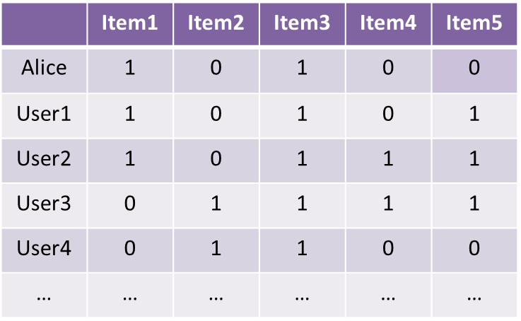
Association Rules for Collaborative Filtering
Association rules are particularly useful for performing recommendations in the context of unary ratings matrices.
unary ratings matrices are created by customer activity
it is generally considered an acceptable practice in sparse unary matrices

Slide 52
Association Rules for Collaborative Filtering
The aforementioned association rules are based on unary ratings matrices, which allow the ability to specify likes, but they do not allow the ability to specify dislikes.
When the number of possible ratings is small, each value of the rating-item combination can be treated as a pseudo-item.
 | Item1&like | Item1&dislike | Item2&like | Item2&dislike | …
Alice | 1 | 0 | 0 | 1 | …
User1 | 1 | 0 | 0 | 0 | …
User2 | 0 | 0 | 0 | 0 | …
User3 | 0 | 0 | 1 | 0 | …
User4 | 0 | 1 | 1 | 0 | …
… | … | … | … | … | …

Slide 53
Association Rules for Collaborative Filtering
(Item = item1,Rating = Like) ⇒ (Item = item2, Rating = Like)
(Item = item1,Rating = Like) AND (Item = item3,Rating = Dislike)⇒ (Item = item5,Rating = Dislike)
 | Item1&like | Item1&dislike | Item2&like | Item2&dislike | …
Alice | 1 | 0 | 0 | 1 | …
User1 | 1 | 0 | 0 | 0 | …
User2 | 0 | 0 | 0 | 0 | …
User3 | 0 | 0 | 1 | 0 | …
User4 | 0 | 1 | 1 | 0 | …
… | … | … | … | … | …

Slide 54
Native Bayes Collaborative Filtering

Slide 55
Bayesian Classification: Why?
A statistical classifier: performs probabilistic prediction, i.e., predicts class membership probabilities
Foundation: Based on Bayes’ Theorem.
Performance: A simple Bayesian classifier, naïve Bayesian classifier, has comparable performance with decision tree and selected neural network classifiers
Incremental: Each training example can incrementally increase/decrease the probability that a hypothesis is correct — prior knowledge can be combined with observed data
Standard: Even when Bayesian methods are computationally intractable, they can provide a standard of optimal decision making against which other methods can be measured

Slide 56
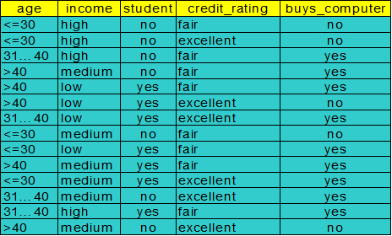
Bayesian Theorem: Basics
Let X be a data sample (“evidence”): class label is unknown
Let H be a hypothesis that X belongs to class C
Classification is to determine P(H|X), (posteriori probability), the probability that the hypothesis holds given the observed data sample X
P(yes|X) > P(no|X)
X => yes
P(yes|X) < P(no|X)
X => no

Slide 57
Bayesian Theorem: Basics
P(H) (prior probability), the initial probability
E.g., X will buy computer, regardless of age, income, …
P(X): probability that sample data is observed
P(X|H) (likelyhood), the probability of observing the sample X, given that the hypothesis holds
E.g., Given that X will buy computer, the prob. that X is 31..40, medium income

Slide 58
Recall a few probability basics
For events a and b:
Bayes’ Rule
Prior
Posterior
Likelihood

Slide 59
Bayesian Theorem
Given training data X, posteriori probability of a hypothesis H, P(H|X), follows the Bayes theorem
Informally, this can be written as
posteriori = likelihood x prior/evidence
Predicts X belongs to C_{i} iff the probability P(C_{i}|X) is the highest among all the P(C_{k}|X) for all the k classes
Practical difficulty: require initial knowledge of many probabilities, significant computational cost

Slide 60
Towards Naïve Bayesian Classifier
Let D be a training set of tuples and their associated class labels, and each tuple is represented by an n-D attribute vector X = (x₁, x₂, …, x_{n})
Suppose there are m classes C₁, C₂, …, C_{m}.
Classification is to derive the maximum posteriori, i.e., the maximal P(C_{i}|X)
This can be derived from Bayes’ theorem
Since P(X) is constant for all classes, only
needs to be maximized

Slide 61
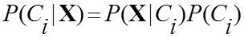
Derivation of Naïve Bayes Classifier
A simplified assumption: attributes are conditionally independent (i.e., no dependence relation between attributes):
MLE

Slide 62
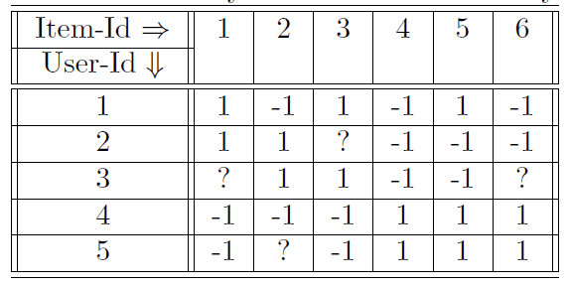
Example of the Bayes Method with Binary Ratings
P(r₃₁=1|r₃₂,r₃₃,r₃₄,r₃₅)
P(r₃₁=1)*P(r₃₂=1|r₃₁=1) *P(r₃₃=1|r₃₁=1)* P(r₃₄=-1|r₃₁=1) P(r₃₅=-1|r₃₁=1)
P(r₃₁=-1|r₃₂,r₃₃,r₃₄,r₃₅)
0.5*0.5*1*1*0.5=0.125

Slide 63
Example of the Bayes Method with Binary Ratings
P(r₃₁=1|r₃₂,r₃₃,r₃₄,r₃₅)
P(r₃₁=-1|r₃₂,r₃₃,r₃₄,r₃₅)
0.5*0.5*1*1*0.5=0.125
P(r31=-1)*P(r32=1|r31=-1) *P(r33=1|r31=-1)* P(r34=-1|r31=1) P(r35=-1|r31=-1)
0.5*(0/1)*(0/2)*(0/2)(0/2)=0
r₃₁=1

Slide 64
Practice
 | I1 | I2 | I3 | I4 | I5 | I6
u1 | 1 | ? | 1 | 1 | 3 | 1
u2 | 1 | 1 | -1 | 1 | 3 | 2
u3 | 1 | -1 | ? | -1 | 1 | 3
u4 | -1 | -1 | -1 | 1 | 2 | 2
u5 | ? | -1 | -1 | ? | 1 | 2
u6 | -1 | ? | 1 | -1 | 1 | 2
Possible rating (1,-1)

Slide 65
Smoothing to Avoid Overfitting
A problem arises when the underlying ratings matrix is sparse and the number of observed ratings is small.
Laplace smoothing
For example, let q₁ . . . q_{l} be the number of users that have respectively specified the ratings, v₁ . . .v_{l} for the jth item.
Laplacian smoothing (parameter α):
The value of α controls the level of smoothing.
Larger value α will lead to more smoothing, but the results will become insensitive to the underlying data.

Slide 66
Example of the Bayes Method with Binary Ratings
P(r₃₁=1|r₃₂,r₃₃,r₃₄,r₃₅)
P(r₃₁=1)*P(r₃₂=1|r₃₁=1) *P(r₃₃=1|r₃₁=1)* P(r₃₄=-1|r₃₁=1) P(r₃₅=-1|r₃₁=1)
(2/4) *((1+1)/(2+2))* ((1+1)/(1+2)* ((2+1)/(2+2))* ((2+1)/(2+2))
P(r₃₁=-1|r₃₂,r₃₃,r₃₄,r₃₅)

Slide 67

Practice
 | I1 | I2 | I3 | I4 | I5 | I6
u1 | 1 | ? | 2 | 1 | 3 | 1
u2 | 2 | 3 | 2 | ? | 3 | 2
u3 | 1 | 3 | ? | 3 | 1 | 3
u4 | 3 | 2 | 1 | 3 | 2 | 2
u5 | ? | 3 | 2 | ? | 1 | 2
u6 | 3 | ? | 2 | 2 | 1 | 2
Possible rating (1,2,3)

Slide 68
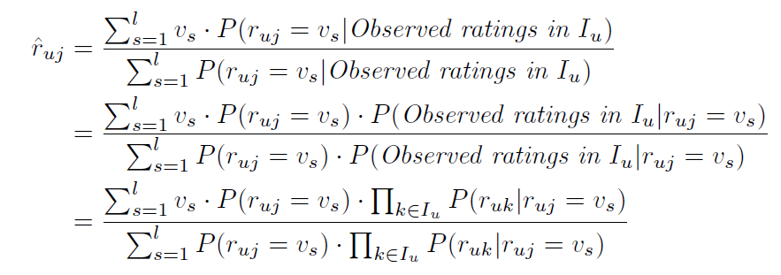
Rather than determining the rating that takes on the maximum probability, one can estimate the predicted value as the weighted average of all the ratings, where the weight of a rating is its probability.
This approach is preferable when the granularity of the ratings distribution is greater.

Slide 69

Example
 | I1 | I2 | I3 | I4 | I5 | I6
u1 | 1 | ? | 2 | 1 | 3 | 1
u2 | 2 | 3 | 2 | ? | 3 | 2
u3 | 1 | 3 | ? | 3 | 1 | 3
u4 | 3 | 2 | 1 | 3 | 2 | 2
u5 | ? | 3 | 2 | ? | 1 | 2
u6 | 3 | ? | 2 | 2 | 1 | 2
Possible rating (1,2,3)
(1*0.1 + 2*0.05 +3*0.04)/(0.1+0.05+0.04) = 1.68

Slide 70
Next week (2022/10/5) will be changed to online course. We will upload the video of the course and if you have questions, you can come to my office during 4:30-5:00 pm on 10/5.

